Slide 1
Digital product design
Lecture 9: Algorithmic Decision Making
Alex Moehring

Slide 2
Outline
Relative strengths / weaknesses of humans & algorithms
Promise of algorithmic decisions
Challenges with algorithmic decisions
Project update

Slide 3
What makes for good decision making

Slide 4
Promise of Algorithmic Decision Making
We often want our decisions to be:
Fast
Taking full advantage of available data
Consistent
Aligned with our objectives
Humans struggle on many of these aspects

Slide 5
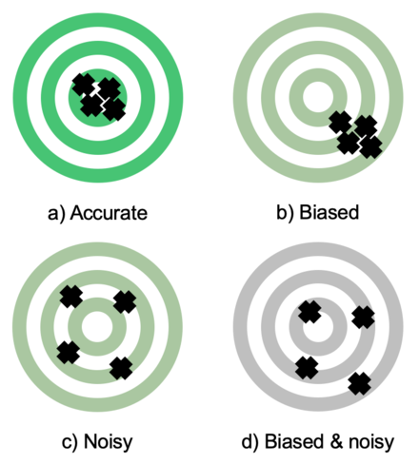
Many Well-Documented Human Prediction Errors
Representativeness
Conjunction Fallacy
Base Rate Fallacy
Confirmation Bias
Noisy Decisions
Mood, time of day, …

Slide 6
Human Prediction Errors: Conjunction Fallacy
Linda is 31 years old, single, outspoken, and very bright. She majored in philosophy. As a student, she was deeply concerned with issues of discrimination and social justice and also participated in anti-nuclear demonstrations.
Which is more probable?
Linda is a bank teller.
Linda is a bank teller and is active in the feminist movement.

Slide 7
Human Prediction Errors: Conjunction Fallacy, Continued
Table 1
Two Examples of Each Kind of Event Pairs Used in Experiments 1 and 2
X | Y ∧ X
The percentage of adolescent smokers in Texas will decrease at least 15% from current levels by September 1, 1999. | The cigarette tax in Texas will increase by $1.00 per pack and the percentage of adolescent smokers in Texas will decrease at least 15% from current levels by September 1, 1999.
By September 1, 1999, an experimental vaccine for childhood leukemia will be announced. | The National Institutes of Health (NIH) will increase spending on vaccine development by 50% in the first 9 months of 1999, and by September 1, 1999, an experimental vaccine for childhood leukemia will be announced.
X | Y ∧ Z
The University of Houston Philosophy Department will hire 3 new faculty members by September 1, 1999. | The University of Houston writing department will be rated in the top 10% nationwide and will announce that it will expand its faculty by September 1, 1999.
By September 1, 1999, Texas will require people to pass a literacy test before serving on a jury. | By September 1, 1999, Texas will start selecting jurors from a pool of licensed drivers rather than registered voters and the number of registered voters will increase by 10%.
X | Y
Bill Clinton will announce his intention to seek a divorce before September 1, 1999. | By September 1, 1999, Janet Reno will announce her intention to run for the Presidency.
Fidel Castro will be removed from political power in Cuba by September 1, 1999. | U.S. forces will be sent to Havana, Cuba before September 1, 1999.

Slide 8
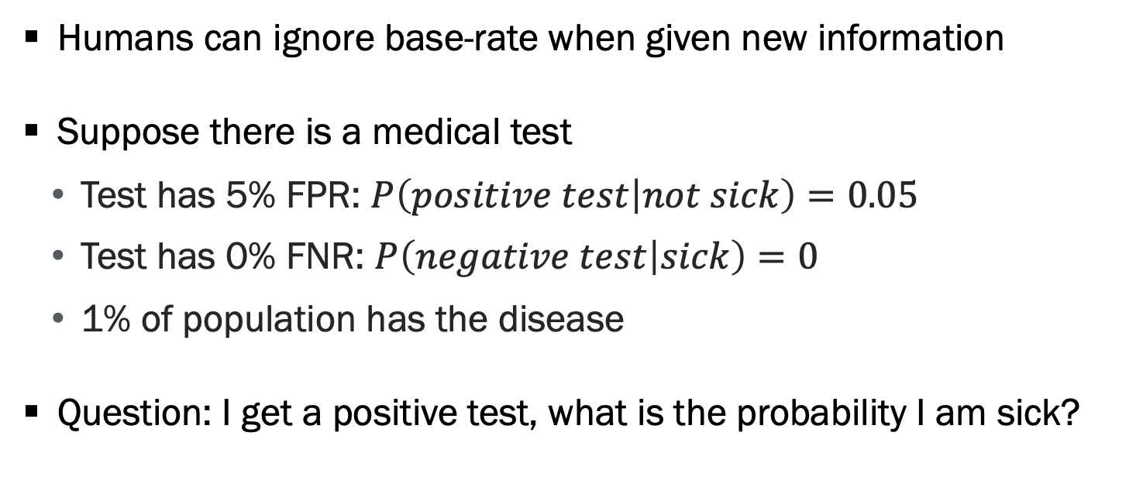
Human Prediction Errors: Base Rate Neglect
Humans can ignore base-rate when given new information
Suppose there is a medical test
Test has 5% FPR: $P\left(positive test | not sick\right)=0.05$
Test has 0% FNR: $P\left(negative test | sick\right)=0$
1% of population has the disease
Question: I get a positive test, what is the probability I am sick?

Slide 9
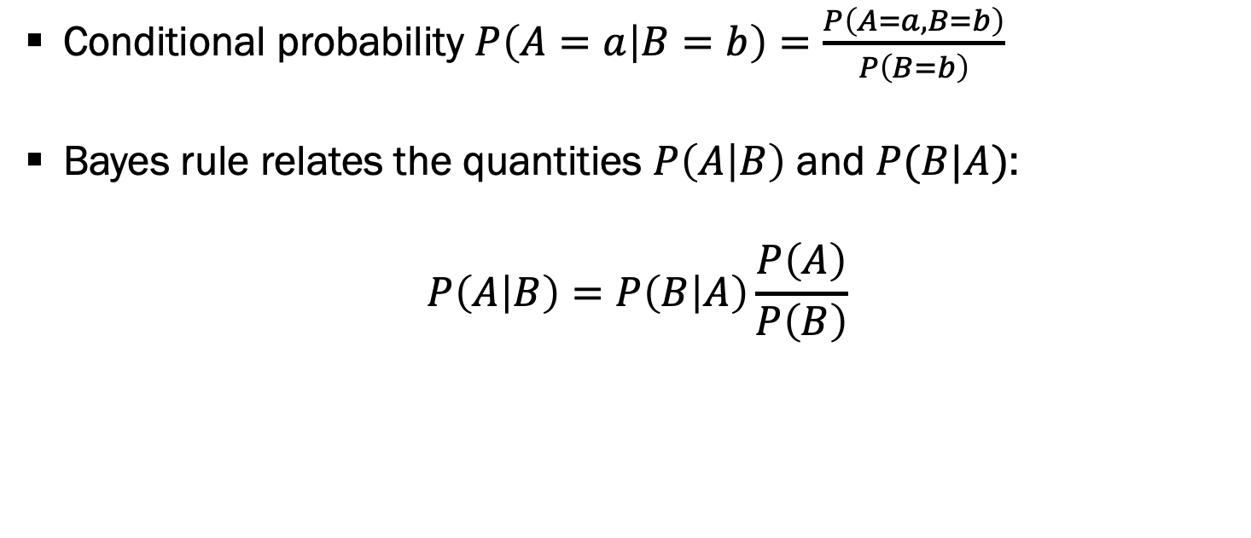
Bayes Rule
Conditional probability $P\left(A=a | B=b\right)=\frac{P\left(A=a,B=b\right)}{P\left(B=b\right)}$
Bayes rule relates the quantities $P\left(A | B\right)$ and $P(B|A)$:
$$P\left(A | B\right)=P\left(B | A\right)\frac{P\left(A\right)}{P\left(B\right)}$$

Slide 10
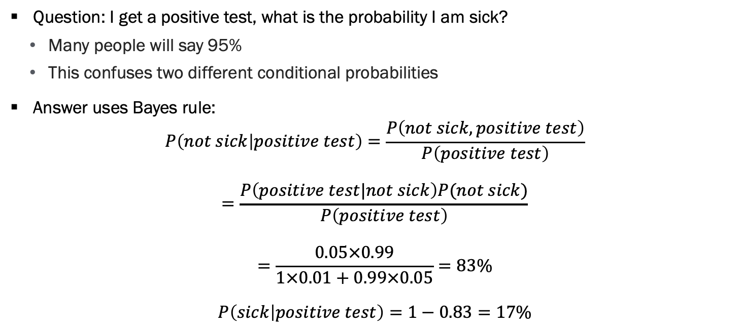
Human Prediction Errors: Base Rate Neglect, Continued
Question: I get a positive test, what is the probability I am sick?
Many people will say 95%
This confuses two different conditional probabilities
Answer uses Bayes rule:
$$P\left(not sick | positive test\right)=\frac{P\left(not sick,positive test\right)}{P\left(positive test\right)}$$
$$=\frac{P\left(positive test|not sick\right)P(not sick)}{P\left(positive test\right)}$$
$$=\frac{0.05×0.99}{1×0.01+0.99×0.05}=83\%$$
$$P\left(sick | positive test\right)=1−0.83=17\%$$

Slide 11
Human Prediction Errors: Noise

Slide 12
Human Prediction Noise: Emotional Judges
Upset loss by local college football team increases juvenile sentence lengths by 34 days
Sentence Length
 | (1) | (2) | (3) | (4)
Upset Loss | 33.806 | 37.003 | 37.654 | 31.683
 | (18.483) | (18.410) | (18.282) | (13.269)
Source: Eren and Mocan (2018)

Slide 13
Comparative Advantage of Humans vs Algorithm
Algorithmic decisions
Instantaneous
Consistent
Makes good use of training data
Objective is clear
Human decisions
Able to use additional data
More explainable?

Slide 14
Promise of Algorithmic Decisions

Slide 15
Why Algorithmic Decisions?
Scale & speed requires automated decisions in many settings
E.g. Impossible to manually curate personalized recommendations for millions/billions of users
Other times we can rely on either human or algorithmic decisions
Growing empirical evidence that algorithms make “better” decisions than humans in many domains
Example application: Fintech automatic loan approval

Slide 16
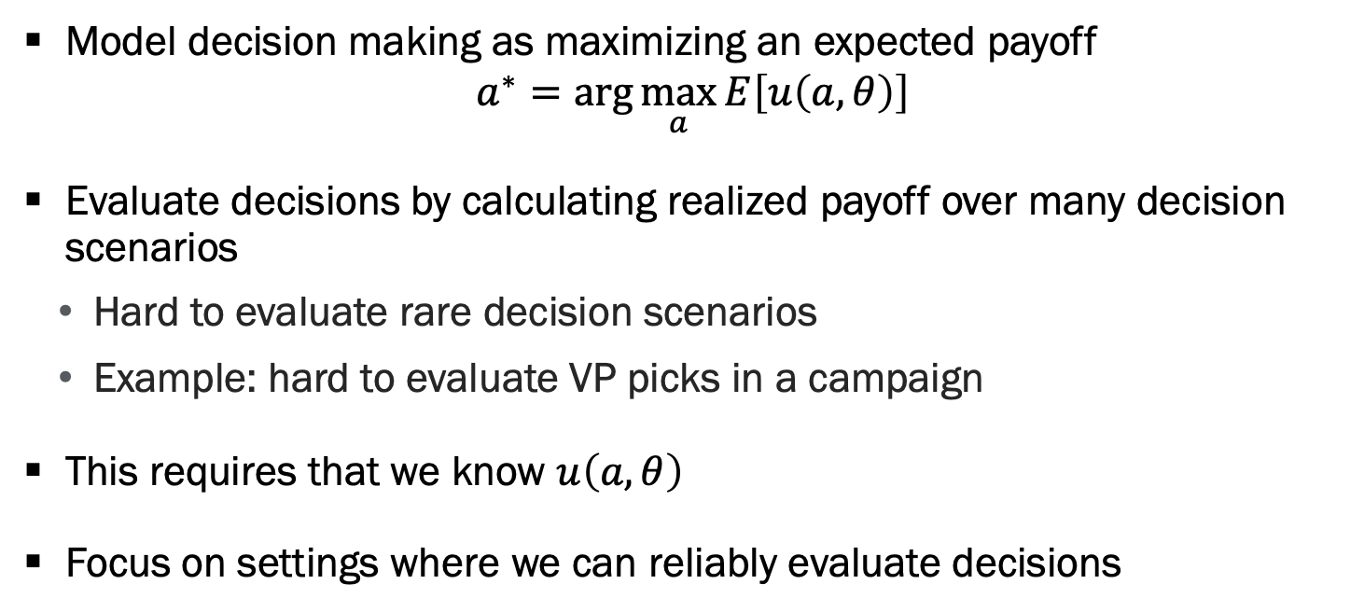
How to Evaluate Decisions?
Model decision making as maximizing an expected payoff
$$a^{∗}=\arg{\max_{a}{E\left[u\left(a,θ\right)\right]}}$$
Evaluate decisions by calculating realized payoff over many decision scenarios
Hard to evaluate rare decision scenarios
Example: hard to evaluate VP picks in a campaign
This requires that we know $u\left(a,θ\right)$
Focus on settings where we can reliably evaluate decisions

Slide 17
Example 1: Medical Testing
A common situation in emergency department
Patient complains of chest pain, trouble breathing, nausea
Decide if person is having a heart attack
Important to decide quickly if we should test for heart attack
A missed heart attack greatly increases mortality
Definitive tests are costly and invasive
Challenging decision as symptoms correlated with benign conditions like acid reflux

Slide 18
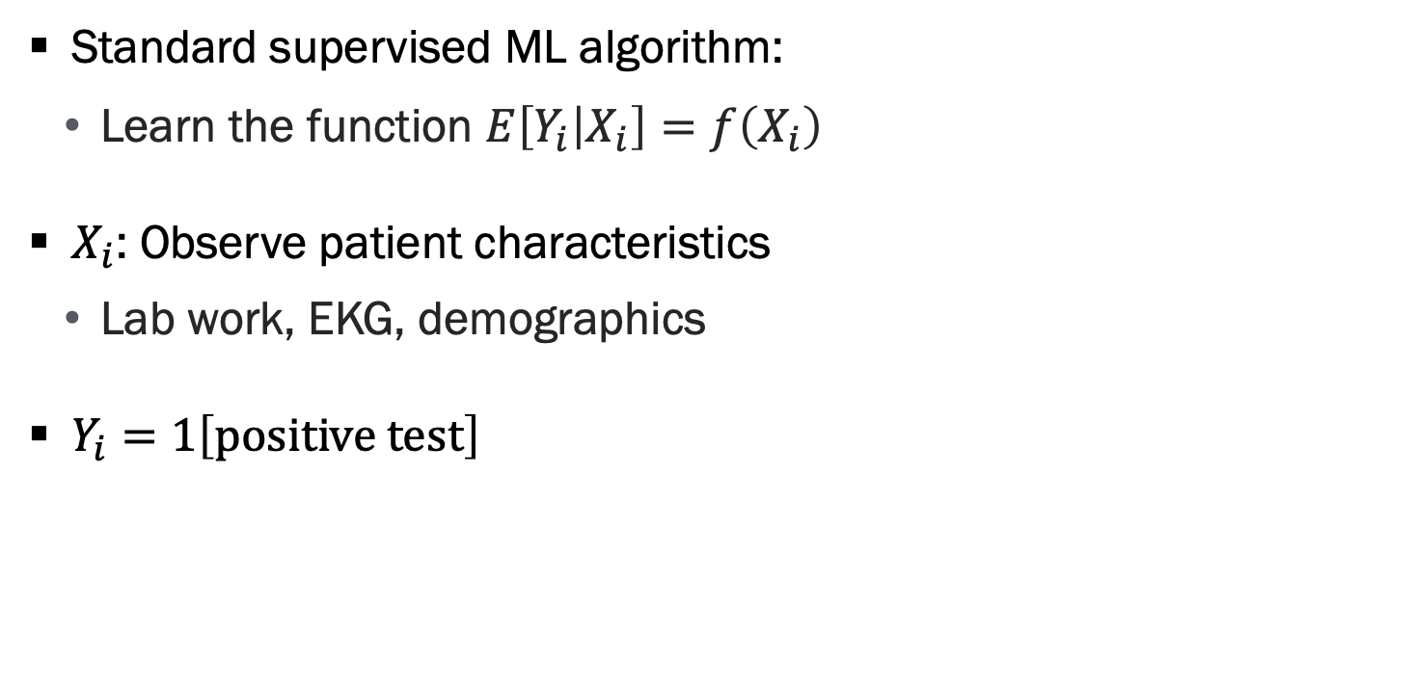
Train Algorithm to Predict Positive Test
Standard supervised ML algorithm:
Learn the function $E\left[Y_{i} | X_{i}\right]=f\left(X_{i}\right)$
$X_{i}$: Observe patient characteristics
Lab work, EKG, demographics
$Y_{i}=1\left[positive test\right]$

Slide 19
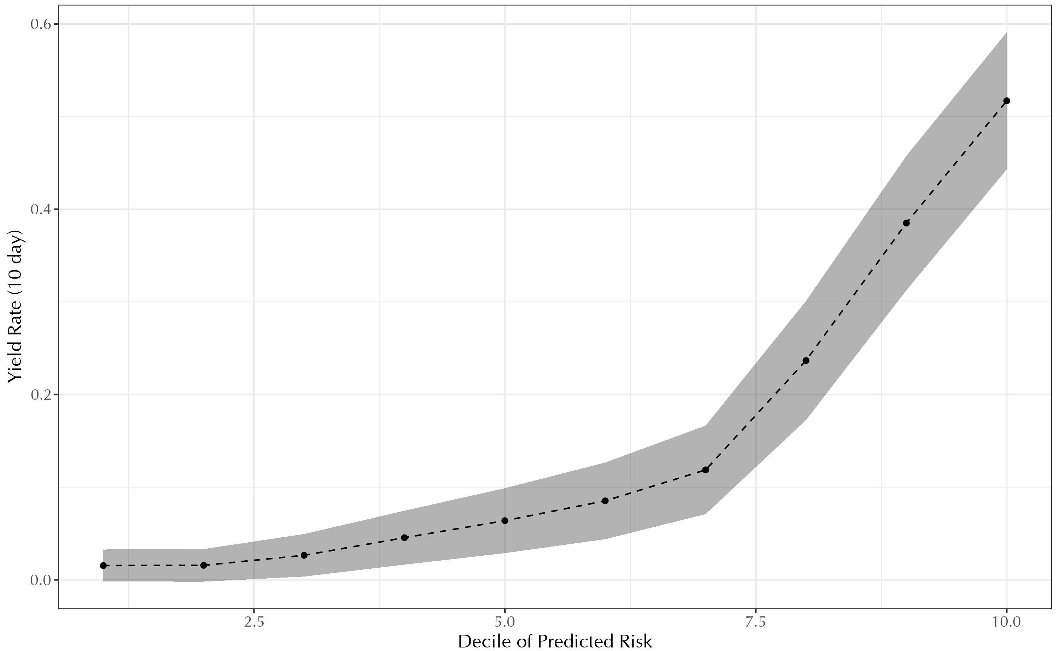
Step 1: Show Algorithm Has Signal
Source: Mullainathan and Obermeyer (2023)

Slide 20
Step 2: Compare Algorithm Decisions to Human Decisions
Most risky patients:
43% yield rate on tests
Only 38% test rate
Prefer to shift tests from less risky patients to more risky patients
Evidence that humans rely on simple model that over weights representative signals
 | Yield Rate (SE) (1) | Test Rate (SE) (3)
Full Sample | 0.146 (0.004) | 0.029 (<0.001)
By Risk Bin
1 | 0.011 (0.006) | 0.012 (<0.001)
2 | 0.036 (0.01) | 0.017 (0.001)
3 | 0.07 (0.014) | 0.047 (0.002)
4 | 0.168 (0.02) | 0.088 (0.004)
5 | 0.429 (0.026) | 0.383 (0.016)
N | 1,784 | 61,965
Source: Mullainathan and Obermeyer (2023)

Slide 21
Example 2: Pre-trial Release Decision
There are ~12 million arrests in the US each year
Following an arrest, a judge decides:
If defendant will await trial at home (i.e on bail)
If defendant will be jailed until their trial
If jailed, defendants can be jailed for many months
Hugely consequential decision
Law dictates a judge should decide solely on prediction of whether a defendant will re-appear and not commit a new crime

Slide 22
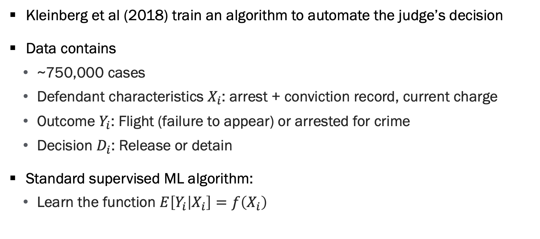
Train an Algorithm to Automate Judge Decision
Kleinberg et al (2018) train an algorithm to automate the judge’s decision
Data contains
~750,000 cases
Defendant characteristics $X_{i}$: arrest + conviction record, current charge
Outcome $Y_{i}$: Flight (failure to appear) or arrested for crime
Decision $D_{i}$: Release or detain
Standard supervised ML algorithm:
Learn the function $E\left[Y_{i} | X_{i}\right]=f\left(X_{i}\right)$
Source: Kleinberg et al (2018)

Slide 23
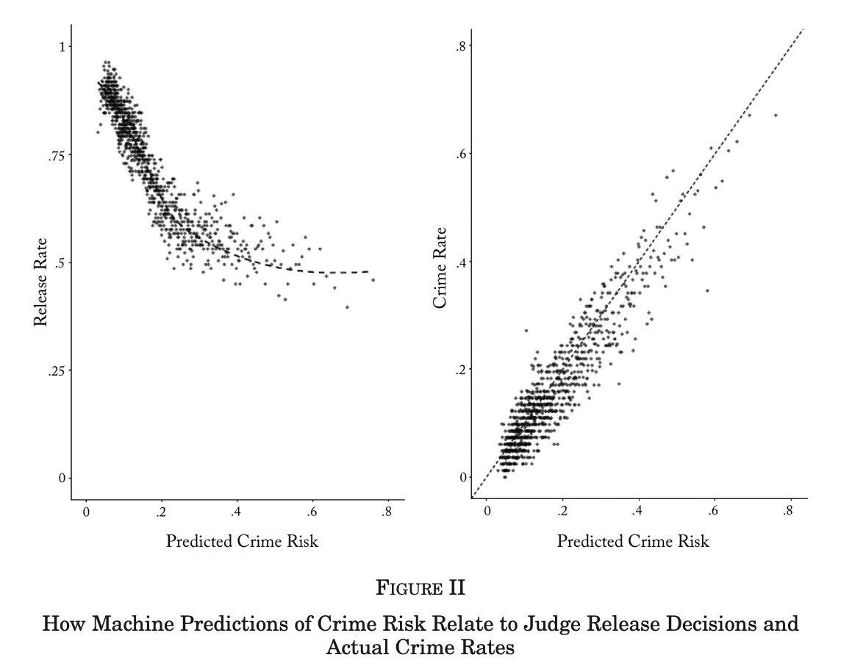
Step 1: Show Algorithm Contains Some Signal Again
Source:
Kleinberg et al (2018)

Slide 24
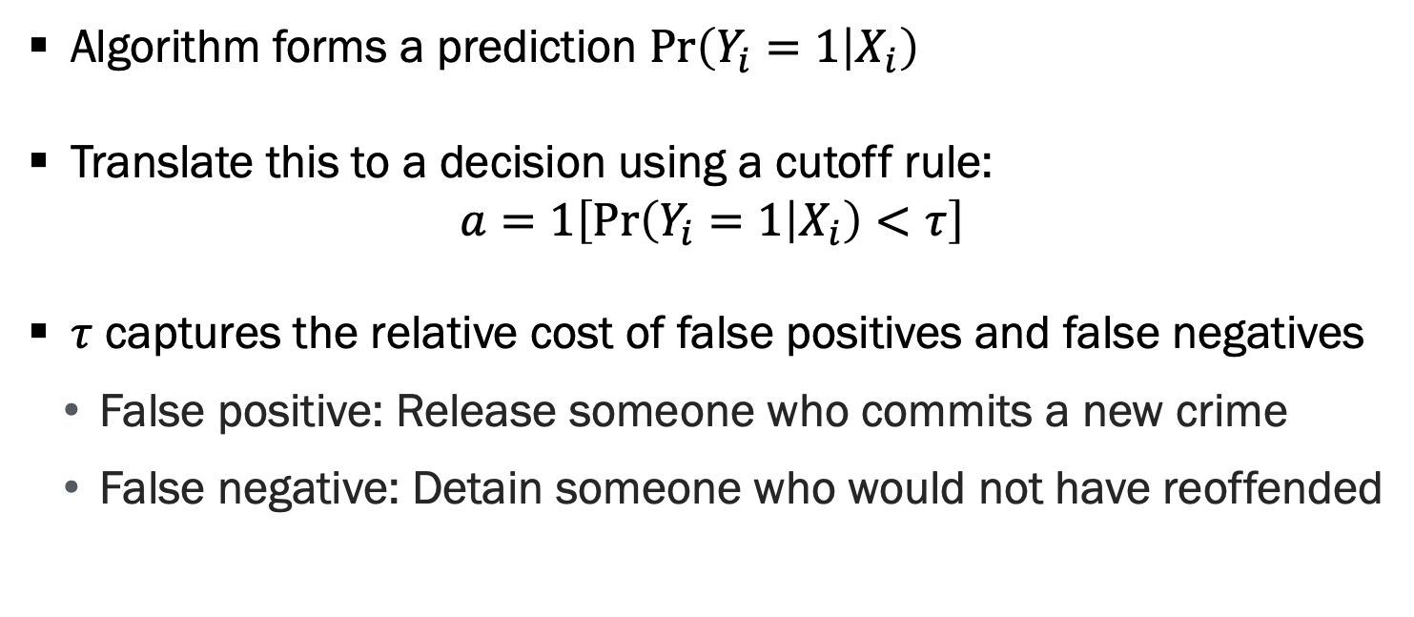
Step 2: Compare Algorithm Decisions to Human Decisions Again
Algorithm forms a prediction $\operatorname{Pr}\left(Y_{i}=1 | X_{i}\right)$
Translate this to a decision using a cutoff rule:
$$a=1\left[\operatorname{Pr}\left(Y_{i}=1 | X_{i}\right)<τ\right]$$
$τ$ captures the relative cost of false positives and false negatives
False positive: Release someone who commits a new crime
False negative: Detain someone who would not have reoffended
Source: Kleinberg et al (2018)

Slide 25
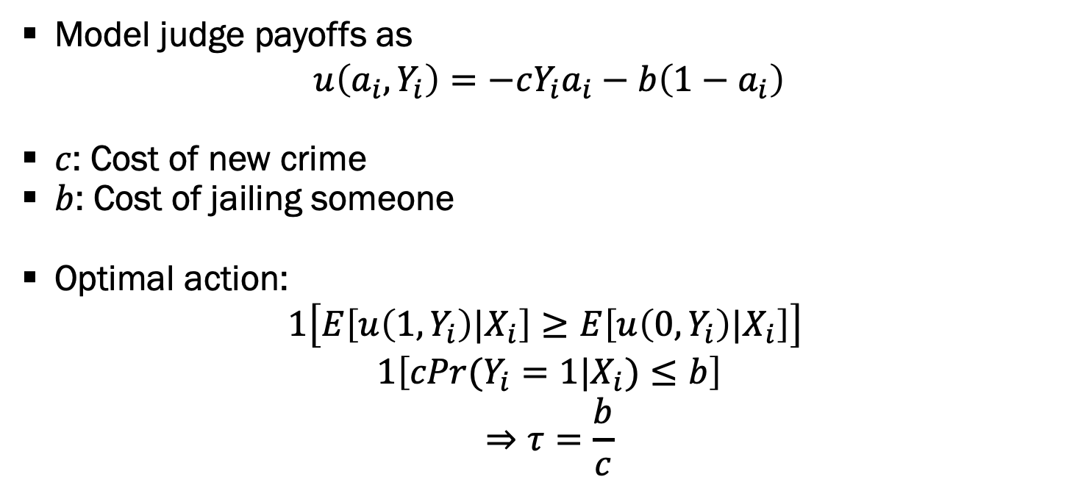
Choosing A Release Threshold
Model judge payoffs as
$$u\left(a_{i},Y_{i}\right)=−cY_{i}a_{i}−b\left(1−a_{i}\right)$$
$c$: Cost of new crime
$b$: Cost of jailing someone
Optimal action:
$$1\left[E\left[u\left(1,Y_{i}\right)|X_{i}\right]≥E\left[u\left(0,Y_{i}\right)|X_{i}\right]\right]$$
$$1\left[cPr(Y_{i}=1|X_{i})≤b\right]$$
$$⇒τ=\frac{b}{c}$$
Source: Kleinberg et al (2018)

Slide 26
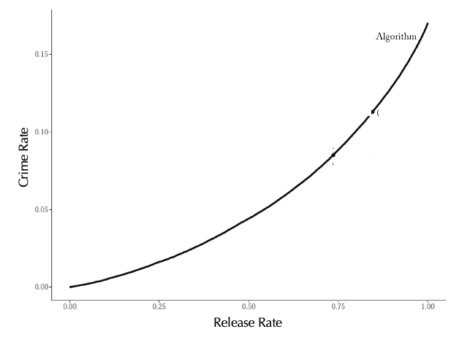
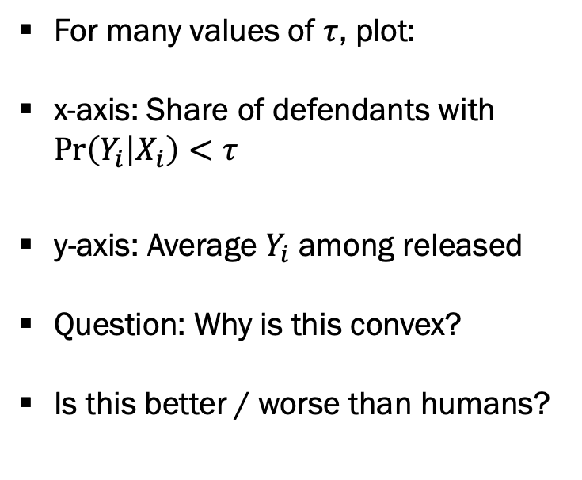
Evaluating Algorithm Decisions
For many values of $τ$, plot:
x-axis: Share of defendants with $\operatorname{Pr}\left(Y_{i} | X_{i}\right)<τ$
y-axis: Average $Y_{i}$ among released
Question: Why is this convex?
Is this better / worse than humans?
Source: Kleinberg et al (2018)

Slide 27
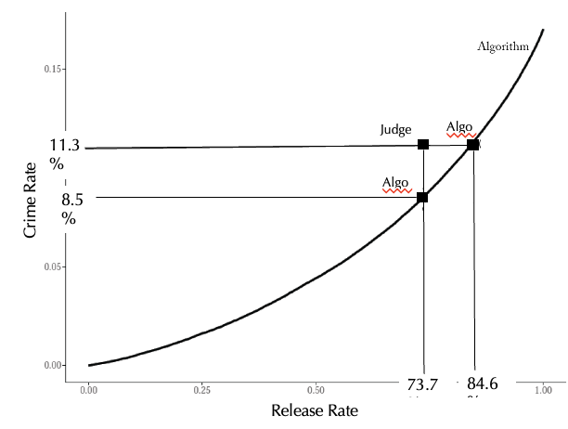
Evaluating Algorithm Decisions, Continued
Add performance of human judge
Keep jail population fixed
Reduce crime rate by 24%
Keep crime rate fixed, reduce jail population by 40%!
Algorithm seems to improve on human decisions!
Source: Kleinberg et al (2018)

Slide 28
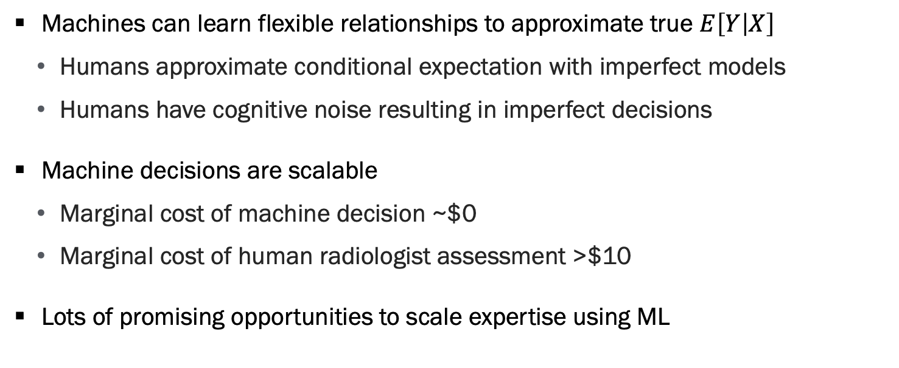
Promise of Algorithmic Decision Making for Machine Decisions
Machines can learn flexible relationships to approximate true $E\left[Y | X\right]$
Humans approximate conditional expectation with imperfect models
Humans have cognitive noise resulting in imperfect decisions
Machine decisions are scalable
Marginal cost of machine decision ~$0
Marginal cost of human radiologist assessment >$10
Lots of promising opportunities to scale expertise using ML

Slide 29
Challenges with algorithmic Decisions

Slide 30
List of Challenges with Algorithmic Decisions
Fairness and algorithmic bias
We’ll talk about this in more detail
Consumers more forgiving of humans than algorithms
Ignores human’s private information
Humans prefer explanations in some settings

Slide 31
Concerns Over Algorithmic Bias
Many well documented situations where algorithms perform differently for different populations
This raises concerns that algorithmic decision-making reinforcing existing biases
These concerns are important
However, one benefit of algorithms is we can inspect and improve the process
Source: Kleinberg et al (2018)

Slide 32
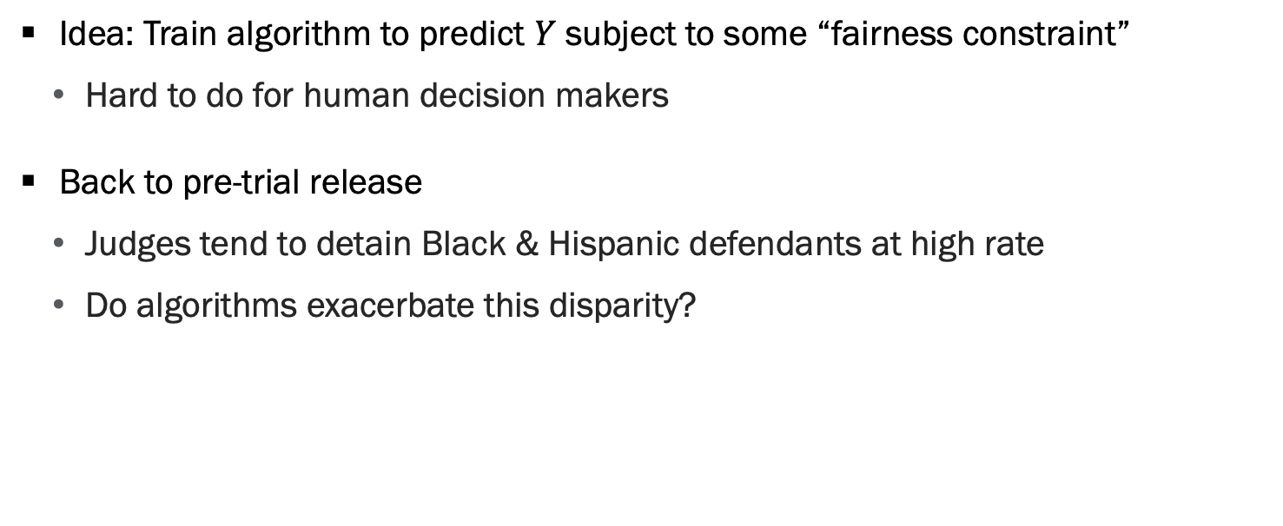
Algorithms Can be Designed to Satisfy Fairness Criteria
Idea: Train algorithm to predict $Y$ subject to some “fairness constraint”
Hard to do for human decision makers
Back to pre-trial release
Judges tend to detain Black & Hispanic defendants at high rate
Do algorithms exacerbate this disparity?
Table 7: Omitted Payoff Bias-Race Disparate Impact of a Complete Re-ranking by Predicted Risk
 | Crime Rate | Drop Relative to Judge | Detention Rate
Release Rule |  |  | Black | Hispanic | Minority
Judge | .1134 (.0010) | 0% | .3101 (.0016) | .2515 (.0021) | .2863 (.0006)
Source: Kleinberg et al (2018)

Slide 33
Recall Two Alternatives Considered
Keep jail population fixed
Reduce crime rate by 24%
Keep crime rate fixed, reduce jail population by 40%
Source: Kleinberg et al (2018)

Slide 34
Algorithms Can be Designed to Satisfy Fairness Criteria, Part 2
Reducing jailing rates has biggest impact on those who tend to be jailed by judges
Table 7: Omitted Payoff Bias-Race Disparate Impact of a Complete Re-ranking by Predicted Risk
 | Crime Rate | Drop Relative to Judge | Detention Rate
Release Rule |  |  | Black | Hispanic | Minority
Judge | .1134 (.0010) | 0% | .3101 (.0016) | .2515 (.0021) | .2863 (.0006)
Algorithm at Judges’ Crime Rate | .1134 (.0010) | 0% | .1899 (.0013) | .1393 (.0017) | .1694 (.0005)
Source: Kleinberg et al (2018)

Slide 35
Algorithms Can be Designed to Satisfy Fairness Criteria, Part 3
Reducing jailing rates has biggest impact on those who tend to be jailed by judges
Holding jailing rates constant, algorithm increases Black detention rate
Table 7: Omitted Payoff Bias-Race Disparate Impact of a Complete Re-ranking by Predicted Risk
 | Crime Rate | Drop Relative to Judge | Detention Rate
Release Rule |  |  | Black | Hispanic | Minority
Judge | .1134 (.0010) | 0% | .3101 (.0016) | .2515 (.0021) | .2863 (.0006)
Algorithm at Judges’ Crime Rate | .1134 (.0010) | 0% | .1899 (.0013) | .1393 (.0017) | .1694 (.0005)
Algorithm at Judges’ Release Rate
Usual Ranking Rule | .0854 (.0008) | -24.68% | .3238 (.0016) | .2404 (.0021) | .2900 (.0006)
Source: Kleinberg et al (2018)

Slide 36
Algorithms Can be Designed to Satisfy Fairness Criteria, Part 4
Reducing jailing rates has biggest impact on those who tend to be jailed by judges
Holding jailing rates constant, algorithm increases Black detention rate
However, we can design algorithm with equity
constraints to eliminate
inequity and reduce crime
Table 7: Omitted Payoff Bias-Race Disparate Impact of a Complete Re-ranking by Predicted Risk
 | Crime Rate | Drop Relative to Judge | Detention Rate
Release Rule |  |  | Black | Hispanic | Minority
Judge | .1134 (.0010) | 0% | .3101 (.0016) | .2515 (.0021) | .2863 (.0006)
Algorithm at Judges’ Crime Rate | .1134 (.0010) | 0% | .1899 (.0013) | .1393 (.0017) | .1694 (.0005)
Algorithm at Judges’ Release Rate
Usual Ranking Rule | .0854 (.0008) | -24.68% | .3238 (.0016) | .2404 (.0021) | .2900 (.0006)
Equal Release Rates for all Races | .0873 (.0016) | -23.02% | .2639 (.0016) | .2639 (.0021) | .2639 (.0006)
Source: Kleinberg et al (2018)

Slide 37
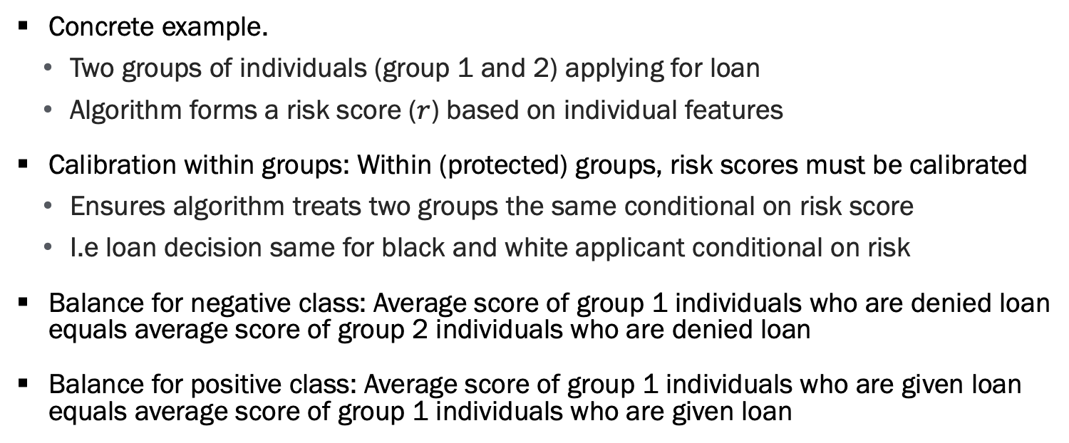
Formal Notions of Algorithmic Fairness
Concrete example.
Two groups of individuals (group 1 and 2) applying for loan
Algorithm forms a risk score ($r$) based on individual features
Calibration within groups: Within (protected) groups, risk scores must be calibrated
Ensures algorithm treats two groups the same conditional on risk score
I.e loan decision same for black and white applicant conditional on risk
Balance for negative class: Average score of group 1 individuals who are denied loan equals average score of group 2 individuals who are denied loan
Balance for positive class: Average score of group 1 individuals who are given loan equals average score of group 1 individuals who are given loan
Source: Kleinberg et al (2016)

Slide 38
Theoretical Result
Except in rare instances, there is no risk assignment (i.e. algorithm) that satisfies all three fairness conditions
Upshot is organization needs to decide how to implement fairness and real tradeoffs exist
This is a value judgement by your organization
This applies to human decision making as well
Source: Kleinberg et al (2016)

Slide 39
Group exercise

Slide 40
Private Information vs. Information Processing
Humans often have access to information not included in algorithm
Experience, judgement, additional data sources (e.g. conversations)
Algorithms better at processing data than humans
Which wins is an empirical question and likely depends on the setting
List settings where:
You think humans have an advantage
You think algorithms have an advantage

Slide 41
Can We Get Best of Both Worlds?
Ideally, we see humans and algorithms collaborate to capitalize on relative strengths of each
What would such a system look like?
We will cover this in detail next Thursday

Slide 42
Questions

Slide 43
Administrative
I will distribute surveys tomorrow morning
Please take them!
Have a great thanksgiving holiday!

